Slide 1
Data independence
Data Abstraction:
A data model is used to hide storage details and present the users with a conceptual view of the database. Program-data independence called data abstraction.
Programs refer to the data model constructs rather than data storage details

Slide 2
Three-Schema Architecture
Proposed to support DBMS characteristics of:
Program-data independence.
Support of multiple views of the data.

Slide 3
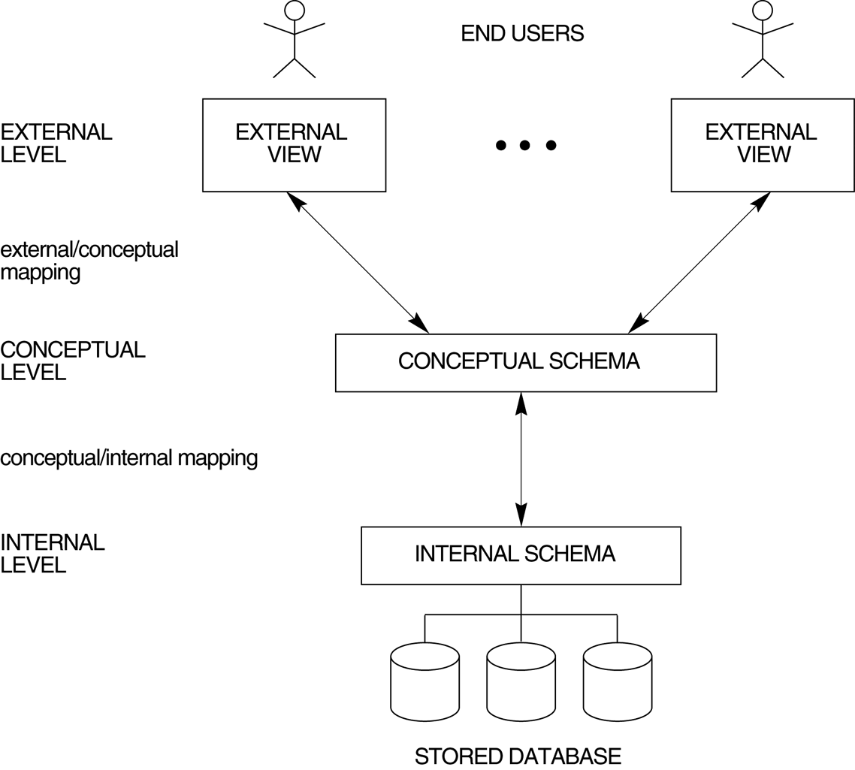
FIGURE 2.2 The three-schema architecture.

Slide 4
Defines DBMS schemas at three levels:
External schemas at the external level to describe the various user views. Usually uses the same data model as the conceptual level.
The external or view level includes a number of external schemas or user views. Each external schema describes the part of the database that a particular user group is interested in and hides the rest of the database from that user group. As in the previous level, each external schema is typically implemented using a representational data model, possibly based on an external schema design in a high-level data model.

Slide 5
Three-Schema Architecture
Conceptual schema at the conceptual level to describe the structure and constraints for the whole database for a community of users. Uses a conceptual or an implementation data model.
At the conceptual level, we have the conceptual schema, which describes all the entities, attributes, and relationships together with integrity constraints.
The logical schema comprises a series of diagrams (i.e., ERD diagrams) that define the content of database tables and describe how the tables are linked together for data access.

Slide 6
Internal schema at the internal level to describe physical storage structures and access paths. Typically uses a physical data model
At the lowest level of abstraction, we have the internal schema, which is a complete description of the internal model, containing the definitions of stored records, the methods of representation, the data fields, and the indexes and storage structures used.

Slide 7
Three-Schema Architecture
Mappings among schema levels are needed to transform requests and data. Programs refer to an external schema, and are mapped by the DBMS to the internal schema for execution.

Slide 8
Data Independence
Logical Data Independence: The capacity to change the conceptual schema without having to change the external schemas and their application programs.
Physical Data Independence: The capacity to change the internal schema without having to change the conceptual schema.

Slide 9
Data Independence
When a schema at a lower level is changed, only the mappings between this schema and higher-level schemas need to be changed in a DBMS that fully supports data independence. The higher-level schemas themselves are unchanged. Hence, the application programs need not be changed since they refer to the external schemas.

